Slide 1
PLEASE GET YOUR SCIENTIFIC CALCULATORS IN THE TUTORIALS

Slide 2
RESISTIVE AC CIRCUITS

Slide 3
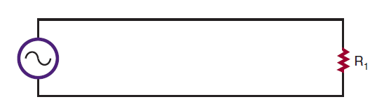
A SIMPLE RESISTIVE CIRCUIT

Slide 4
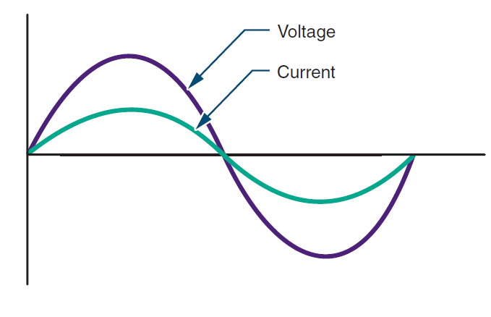
VOLTAGE AND CURRENT RELATION

Slide 5
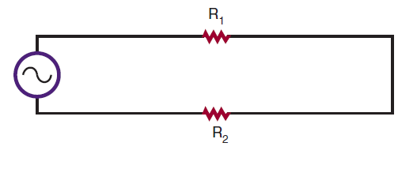
RESISTORS IN Series

Slide 6
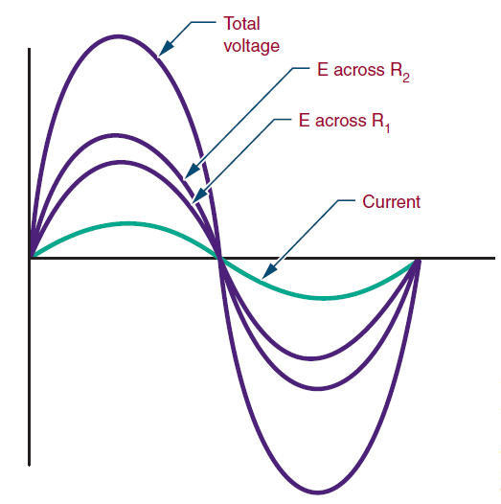
VOLTAGE AND CURRENT RELATION

Slide 7
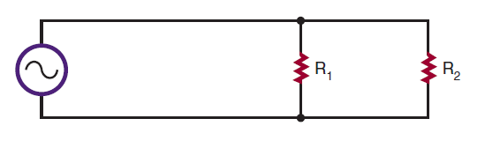
RESISTORS IN PARALLEL

Slide 8
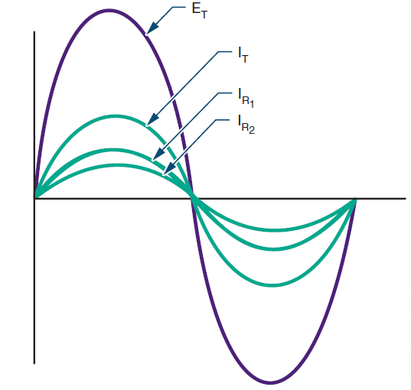
VOLTAGE AND CURRENT RELATION

Slide 9
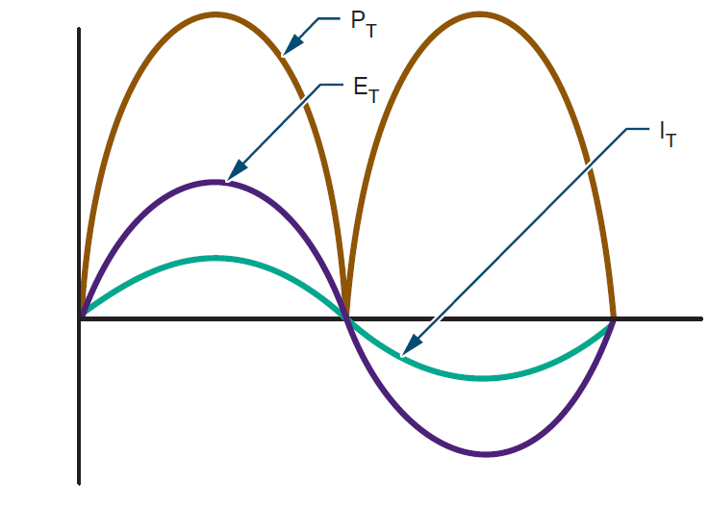
POWER IN AN AC RESISTIVE CIRCUIT

Slide 10
CAPACITORS IN AC CIRCUITS

Slide 11
When AC Voltage applied to a capacitor
Electrons donot pass through the dielectric
Movement of electrons from one plate to another represents the current flow.
As AC Voltage increases and decreases in amplitude, capacitor charges and discharges

Slide 12
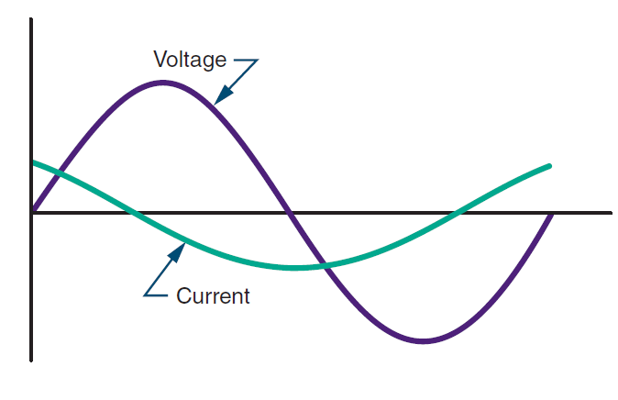
ICE

Slide 13
The opposition that the capacitors offer to the applied AC voltage is called CAPACITIVE REACTANCE
Xc= 1/2πfC
Effect of Frequency and Capacitance
Ohm’s law with reactance
Capacitive reactance in series and parallel when capacitors are connected in series and parallel respectively.

Slide 14
APPLICATIONS OF CAPACITIVE CIRCUITS
FILTERING
COUPLING AND DECOUPLING
AS PHASE SHIFTERS and many others……

Slide 15
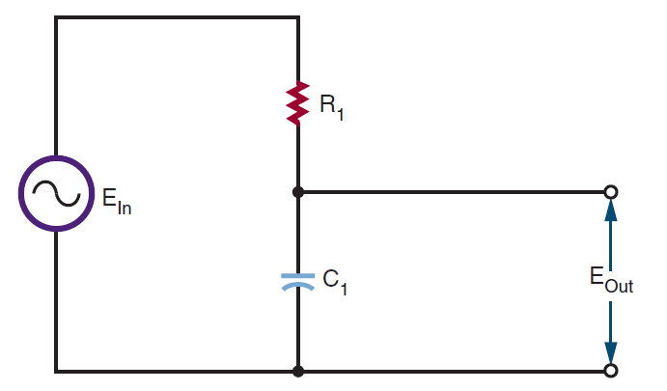

Slide 16
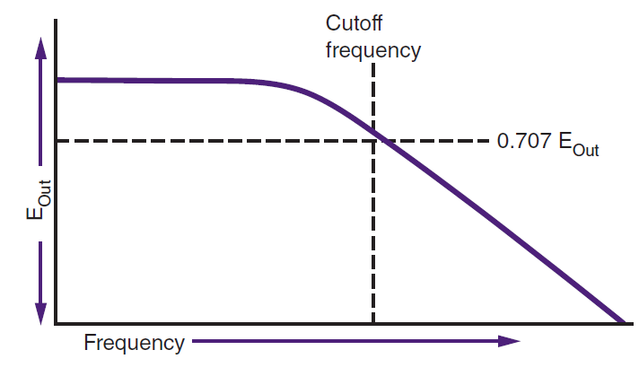

Slide 17
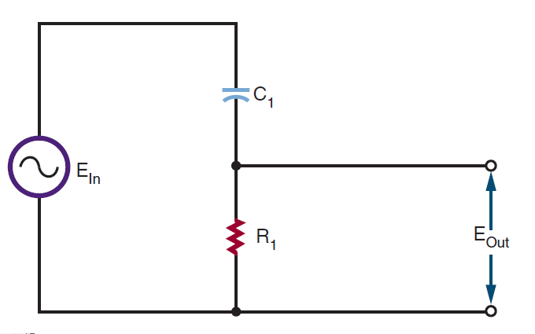

Slide 18
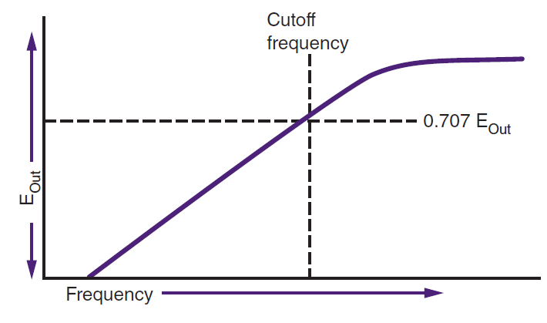

Slide 19
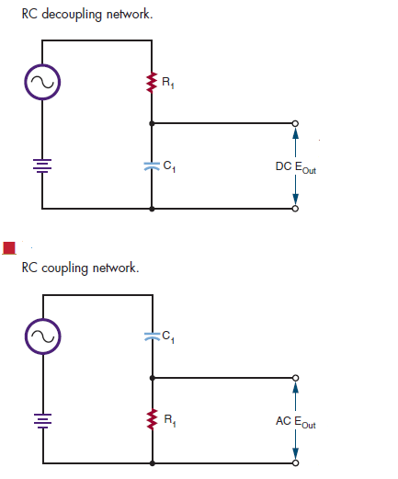

Slide 20
RC PHASE SHIFTERS
Can be used where small amounts, less than 60 degrees of phase shift are desired.

Slide 21
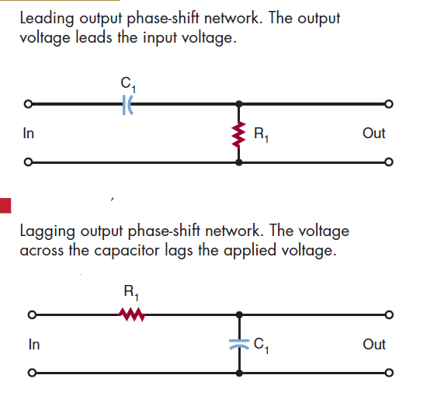

Slide 22
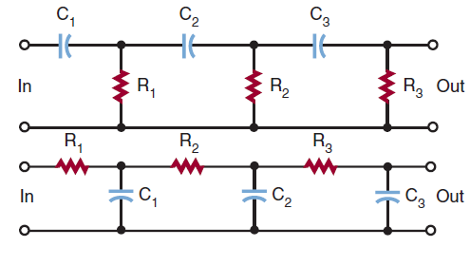
Networks cascaded to form greater phase shifts

Slide 23
INDUCTORS IN AC CIRCUITS

Slide 24
TRY AND MAINTAIN SYMMETRY WITH CAPACITORS

Slide 25
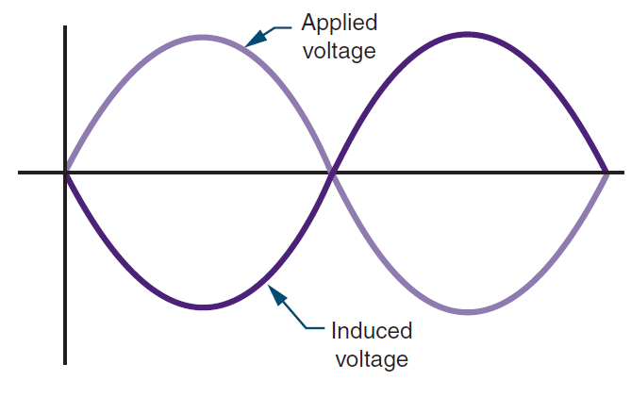

Slide 26
This opposition is effective in reducing the current flow as a resistor

Slide 27
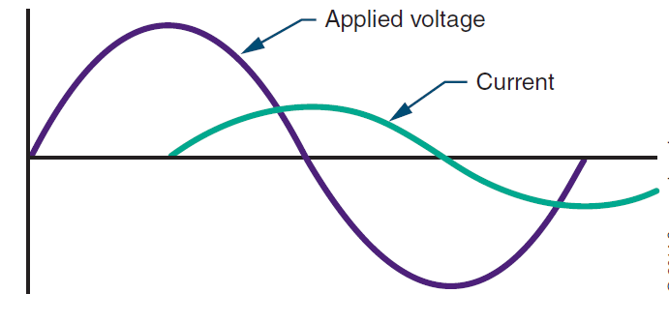
ELI

Slide 28
IMPEDANCE
Vector sum of inductive reactance and resistance in the circuit

Slide 29
APPLICATIONS OF INDUCTIVE CIRCUITS
Disadvantages of Inductors
Advantages of Inductors

Slide 30
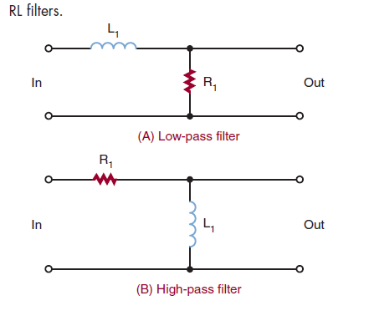

Slide 31
CUT OFF FREQUENCY
fc= 1/ 2πƬ

